Slide 1

SPSS
Sheeba Selvapattu

Slide 2
SPSS stands for statistic package for social science
SPSS develops as a programming language, and it is designed to provide statistical analysis.
SPSS is a complex and powerful application which have a graphical and syntactical interface. It is used to provide dozens of functions for managing, analyzing, and presenting data.

Slide 3
Statistics is a branch of mathematics that is used for organization and interpretation of the numerical data.

Slide 4
Data Management in SPSS
SPSS holds data in the same way as many other programs, with columns dedicated to different variables, and one observation (or participant) per row. This is the main way to view your data in SPSS, though you can also view just the list of variables in the dataset as well. These two data views have different uses; the variable view allows you to label categories, rename variables, and change each variable’s type, but does not allow you to see the data or edit any actual data entries.
Switching between the two views is as easy as double clicking on a variable’s number (in variable view) or a variable’s name (in data view), holding CTRL and pressing T, or selecting the view format from the tabs at the bottom of either window.

Slide 6
The first step in creating your data set is usually naming the variables, but might be skipped if your data are downloaded with variable names already included. Double clicking the variable name allows it to be renamed as needed.
Clicking on the values in the value column allows you to assign labels to different numbers.

Slide 7
the measure column. This allows you to show what kind of data each variable holds. Ordinal data is usually used to identify Likert-type responses, where participants respond with a set of ordered categories. Scale variables, like the number of times a participant has done a certain task, should be labeled scale, while nominal variables are those that contain categories with no specific order, like ethnicity or gender. These can be changed with a simple drop-down.
Having a nice clean dataset is the first step to getting your thoughts organized, and makes your output much easier to interpret.

Slide 8
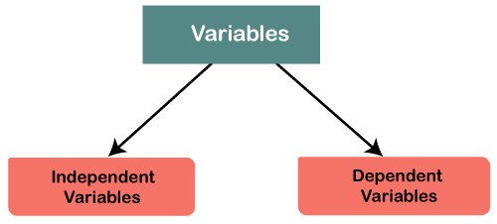
SPSS Variables
The data entry in SPSS begins with understanding the variables like our variable nam
two types of variables, i.e., independent variables and dependent variables.

Slide 9
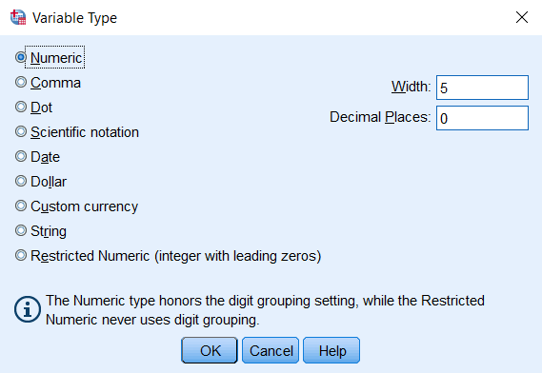
A variable's type determines if a variable numeric or character, quantitative or qualitative. It also dictates what type of statistical analysis methods are appropriate for that data.

Slide 10
NUMERIC
Numeric variables, as you might expect, have data values that are recognized as numbers. This means that they can be sorted numerically or entered into arithmetic calculations. When viewed in the Data View window, system-missing values for numeric variables will appear as a dot (i.e., “.”)

Slide 11
STRING
String variables -- which are also called alphanumeric variables or character variables -- have values that are treated as text. This means that the values of string variables may include numbers, letters, or symbols. In the Data View window, missing string values will appear as blank cells.

Slide 12
COMMA
Numeric variables that include commas that delimit every three places (to the left of the decimals) and use a period to delimit decimals. SPSS will recognize these values as numeric even if they contain commas or use scientific notation.
Example: Thirty-thousand and one half: 30,000.50

Slide 13
DOT
Numeric variables that include periods that delimit every three places and use a comma to delimit decimals. SPSS will recognize these values as numeric even if they contain periods or use scientific notation.
Example: Thirty-thousand and one half: 30.000,50

Slide 14
SCIENTIFIC NOTATION
Numeric variables whose values are displayed with an E and power-of-ten exponent. Exponents can be preceded by either an E or a D, with or without a sign, or only with a sign (no E or D). SPSS will recognize these values as numeric, with or without an exponent.
Example: 1.23E2, 1.23D2, 1.23E+2, 1.23+2.

Slide 15
DATE
Numeric variables that are displayed in any standard calendar date or clock-time formats. Standard formats may include commas, blank spaces, hyphens, periods, or slashes as space delimiters.
Example: Dates: 01/31/2013, 31.01.2013

Slide 16
DOLLAR
Numeric variables that contain a dollar sign (i.e., $) before numbers. Commas may be used to delimit every three places, and a period can be used to delimit decimals.
Example: Thirty-three thousand dollars and thirty-three cents: $33,000.33

Slide 17
CUSTOM CURRENCY
Numeric variables that are displayed in a custom currency format. You must define the custom currency in the Variable Type window. Custom currency characters are displayed in the Data Editor but cannot be used during data entry.

Slide 18
RESTRICTED NUMBER
Numeric variables whose values are restricted to non-negative integers (in standard format or scientific notation). The values are displayed with leading zeroes padded to the maximum width of the variable.
Example: 00000123456 (width 11)

Slide 19
Importing Data from an Excel File
To import data from an Excel spreadsheet into SPSS, first make sure your Excel spreadsheet is formatted according to these criteria:
The spreadsheet should have a single row of variable names across the top of the spreadsheet in the first row.
Variable names should include ordinary letters, numbers, and underscores (e.g., Gender, Grad_Date, Test_1) and not include special characters (e.g., "Graduation Date" would not be a valid variable name because it contains a space).

Slide 20
The data should begin in the first column, second row (beneath the variable names row) of the spreadsheet.
Anything that is not part of the data itself (e.g., extra text, labels, graphs, Pivot Tables) should be removed.
Missing values for string or numeric variables have blank (empty) cells, or an appropriate predetermined missing value code (such as -999).

Slide 21
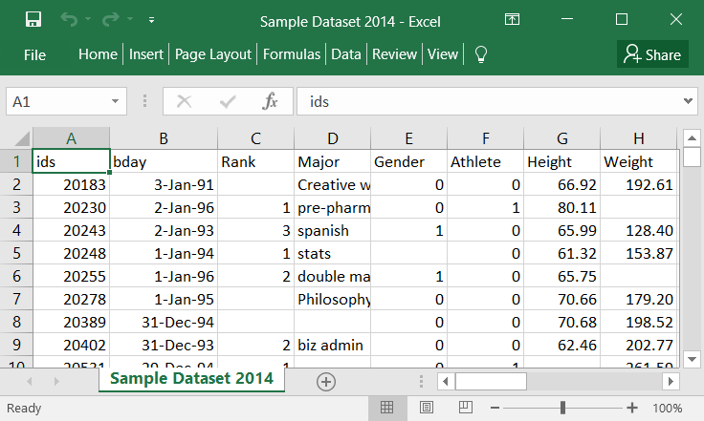

Slide 22
once the data in your Excel file is formatted properly it can be imported into SPSS by following these steps:
1. Click File > Open > Data. The Open Data window will appear.
2. In the Files of type list select Excel (*.xls, *.xlsx, *.xlsm) to specify that your data are in an Excel file. If you do not specify the type of file that you wish to open, your file will not appear in the list of available files. Locate and click on your file. The file name will appear in the File name field. Click Open.

Slide 23
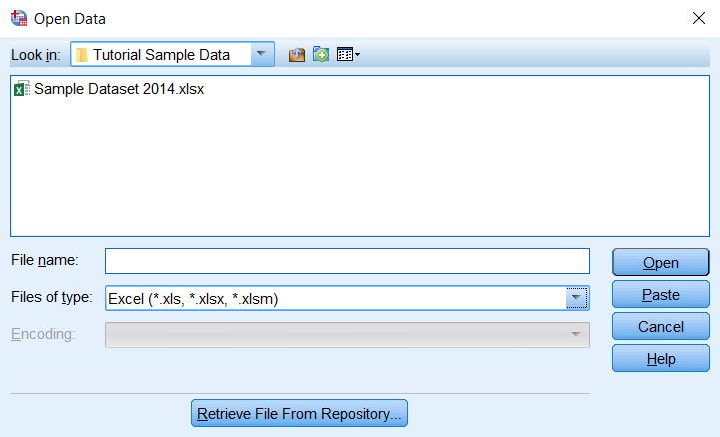

Slide 24
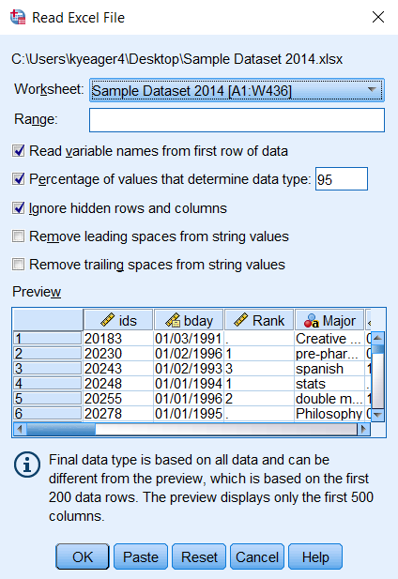
3. If you are using SPSS Version 25, the Read Excel File window will appear.

Slide 25
In the Worksheet dropdown menu, select the sheet from your Excel workbook that contains your data. (If you have not assigned names to the sheets in your Excel workbook, the labels you see here will usually be Sheet1, Sheet2, Sheet3, etc.) You can only import one sheet from your Excel file at a time.
If your variable names are in the first row of data, select the Read variable names from the first row of data check box.
The options Remove leading spaces from string values and Remove trailing spaces from string values only affect variables that are imported as strings. The former will remove any whitespace characters that appear at the start of the string, and the latter will remove any whitespace characters at the end of the string. This is optional, but is often convenient, since leading and trailing spaces can appear invisible to the user, but cause SPSS to think that otherwise identical strings are distinct.

Slide 26
You may also specify the range of rows/columns to import if you wish. It is suggested to keep the default value unless you have a reason for altering it.
Click OK when you are finished.

Slide 27
inferential statistical methods
While descriptive statistics summarize the characteristics of a data set, inferential statistics help you come to conclusions and make predictions based on your data.
When you have collected data from a sample, you can use inferential statistics to understand the larger population from which the sample is taken.
Inferential statistics have two main uses:
making estimates about populations.
testing hypotheses to draw conclusions about populations.

Slide 28
Graphs in SPSS

Slide 29
THANK YOU

